Slide 1
The USA to World War Two……
Section One: So what do you know???

Slide 2
USA Quiz!
Name the European explorer who is credited with finding north America and when?
Why is this incorrect?
Name two European countries which colonised north America.
Complete this expression…”go west…” (two more words!)

Slide 3
5. What is ‘frontier confrontation’?
6. Which technology opened the interior?
7. Name the American actor famous for his portrayal of tough cowboys.
8. What was the ‘slave trade’?
9. In which part of 1850s America would you find slaves?
10. Which city was originally named New Amsterdam?
11. What was the ‘Boston Tea Party’?

Slide 4
12. July 4, 1776 is known today as…?
13. Why?
14. Who was the first President of the USA?
15. What is the official name of the USA flag?
16. Both the USA and Australia have a Constitution. But the USA also has a ………… which Australia does not.
17. Both countries had gold rushes…when was the Californian gold rush?
18. Whilst on California, on which coast is it found?

Slide 5
19. Who was President of the North during the American Civil War?
20. Did the northern or southern states win this war? When was it (decade)?
21. Name a very famous 1930s film made about this war.
22. In 1867, Alaska was purchased from who by the Americans? (think geography…!)
23. Who was Geronimo?
24. What does the term “separate but equal” mean and to whom did it apply in the late 19thC?
25. The last state to join the USA was….?

Slide 6
26. When did the USA join WW1?
27. Name the President at this time?
28. Name the two key political parties in the USA?
29. Who is the current President and to which party does he belong?
30. Which international organisation did the USA found but not join after WW1?
31. What is a “flapper”?
32. What was Prohibition?
33. Women in the USA got the vote before women in Australia. True or False?

Slide 7
34. What did the Ku Klux Klan hate?
35. When did the Great Depression occur in the USA?
36. Which US President spent time on the Kalgoorlie goldfields in his youth?
37. What disease did President Roosevelt contract?
38. What is a dime?
39. Who were - Charlie Chaplin? Shirley Temple? Al Capone? Henry Ford?
40. When and why did the USA enter WW2?

Slide 8
Answers……………………..
Columbus 1492
People of the First Nations arrived before Europeans.
Spain, England
“Go west young man!”
Contact between whites and Europeans with the people of the First Nations.
Railways
John Wayne

Slide 9
8. Trading Africans for goods or money during the late 18 and 19th Cs.
9. In the southern states
New York
Action taken by citizens in Boston against taxes placed on them by the British. They threw tea overboard in 1773 - think film “The Patriot” .
Independence Day
The day American ‘patriots’ declared their independence from Britain - led to war.
George Washington.

Slide 10
15. ‘Stars and Stripes’
16. Bill of Rights
17. 1849 - miners known as the ‘49ers’ came to Australia in early 1850s led to gold rush.
18. West coast
19. Abraham Lincoln in 1860 - 65
20. Northern Union States “yankees” beat the southern Confederate States “Johnny Rebs”, 1861-65, 500,000 dead, Lincoln assassinated.
21. Gone with the Wind
22. Russian Empire
23. Leader of the Apache First Nations people.
24. Applied to African Americans(blacks) and confirmed segregation in the south despite Civil War and constitutional amendments.

Slide 11
25. Hawaii in 1898.
1917, April.
Woodrow Wilson
Republican and Democrat
Barak Obama, Democrat
League of Nations (forerunner of the UNO)
A liberated young woman in the 1920s.
Banning of the sale and consumption of alcohol in the US from 1919 - 1933.
False - Australia 1906, USA - 1921.
African Americans, Jews, some migrants.

Slide 12
35. From Oct. 28 1929 - the late 1930s. Partial recovery under Roosevelt’s ‘New Deal’ but in reality WW2 ended the Depression around the world.
36. Herbert Hoover, 1929 - 1932.
37. Polio
38. A coin - 10c
39. Chaplin was a actor, director and film producer, particularly comedy. Temple was a child actor of the 1930s. Capone was a gangster, part of the mafia of the late 1920s - most money made from illegal sale of alcohol. Ford - Ford cars - Model A…any colour you like as long as it is black!
40. December 7, 1941…a Sunday….. “..we have awakened a sleeping giant…”

Slide 13
Section Two – cartoons!....old ones!!!!!

Slide 14
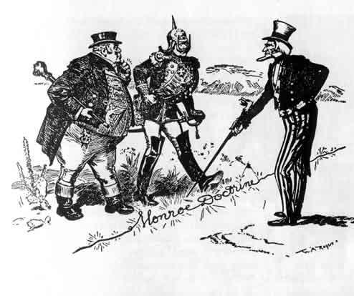
Identify the characters and which country each represents.
New York Herald.
“That’s a Live Wire, Gentlemen.”
1902.
http://www.granger.com/results.asp?inline=true&image=0057057&wwwflag=1&itemx=7&screenwidth=1225

Slide 15
The Monroe Doctrine (after President James Monroe) was a US foreign policy regarding Latin American countries in 1823. It stated that further efforts by European nations to colonise land or interfere with states in North or South America would be viewed as acts of aggression, requiring U.S. intervention

Slide 16
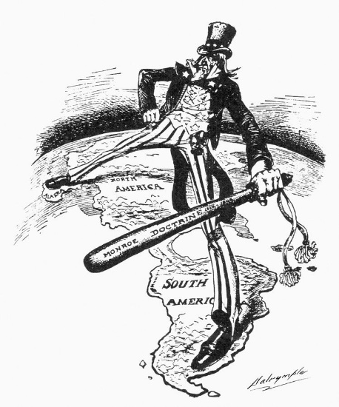
What techniques does the cartoonist use to illustrate the American pov about the Monroe Doctrine?

Slide 17
1. What events/issues might have triggered the need for the Monroe Doctrine in the 1820s? (think – context of this period of history….)
2. How might this doctrine be of benefit to the American people?
3. How might it be a disadvantage?
The next two cartoons illustrate some contemporary advantages and disadvantages.

Slide 18
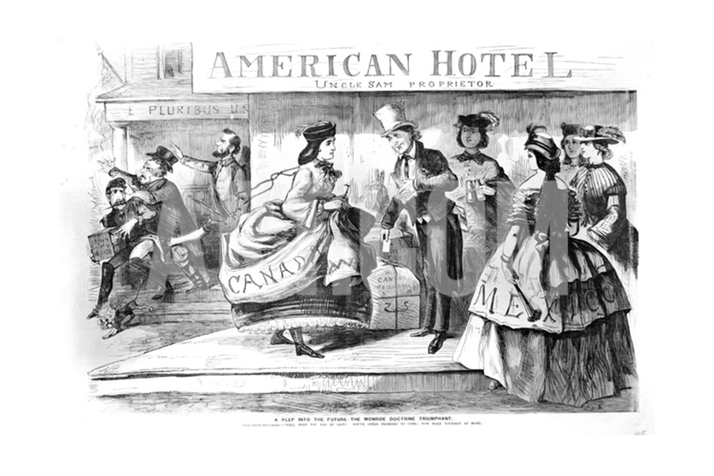
http://eu.art.com/products/p22112508326-sa-i7626288/a-peep-into-the-future-the-monroe-doctrine-triumphant-cartoon-from-frank-leslie-s-budget-of.htm?sOrig=CAT&sOrigID=0&dimVals=0&ui=1357CAE11D0D4F0EBCCD8686CA0B4F7B&searchstring=Monroe+Doctrine&SSK=Monroe+Doctrine
1863

Slide 19
Consider this for a moment…..
A privateer or "corsair" was a private person or ship authorised by a government by letters of marque (a license) to attack foreign vessels during wartime.
Privateering was a way of mobilising armed ships and sailors without having to spend treasury resources or commit naval officers
en.wikipedia.org/wiki/Privateer

Slide 20
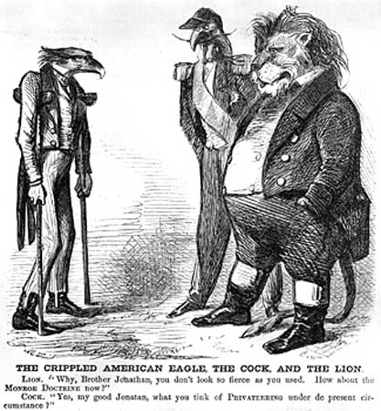
1870s.
In the aftermath of the destructive American Civil War, some thought the U.S. was in no shape to uphold and enforce the Monroe Doctrine. The lion is England, the cock, France.
So, how was the Monroe Doctrine travelling?

Slide 21
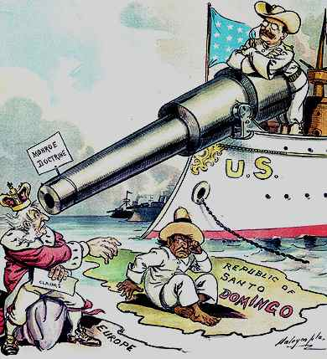
Roosevelt’s ‘Big Gun’
The cartoon illustrates the growing strength of the United States. Where before the U.S. required British support to uphold an American doctrine, by Theodore Roosevelt’s presidency (1901-1909) the U.S. has become a hemispheric (or regional) power in its own right. Note the ‘White Fleet’
http://zgeography.wordpress.com/2013/12/17/geopolitical-cartoons-monroe-and-roosevelt-1900s/

Slide 22
So…. Back to the cartoon….
What else does this cartoon tell you about the world at the time of publication?
New York Herald.
“That’s a Live Wire, Gentlemen.”
1902.
http://www.granger.com/results.asp?inline=true&image=0057057&wwwflag=1&itemx=7&screenwidth=1225

Slide 23
Write three to four sentences outlining the message of this 1902 American cartoon. That’s a live wire, gentlemen.(3m)

Slide 24
Many cartoonists take ‘old’ cartoons or iconic images and set them into the present context…ie in their own time.

Slide 25
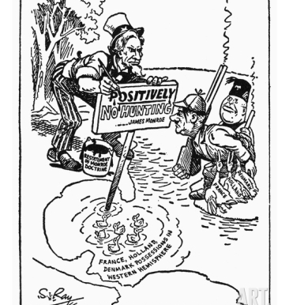
1930s
Ink bucket states “Reinstatement of
the Monroe Doctrine.”
Who are the characters?
Give meaning to the elements of the cartoon.
What is the message?
Purpose?? (think –
How does the
cartoonist want the ‘audience’
to react to this
cartoon?)

Slide 26
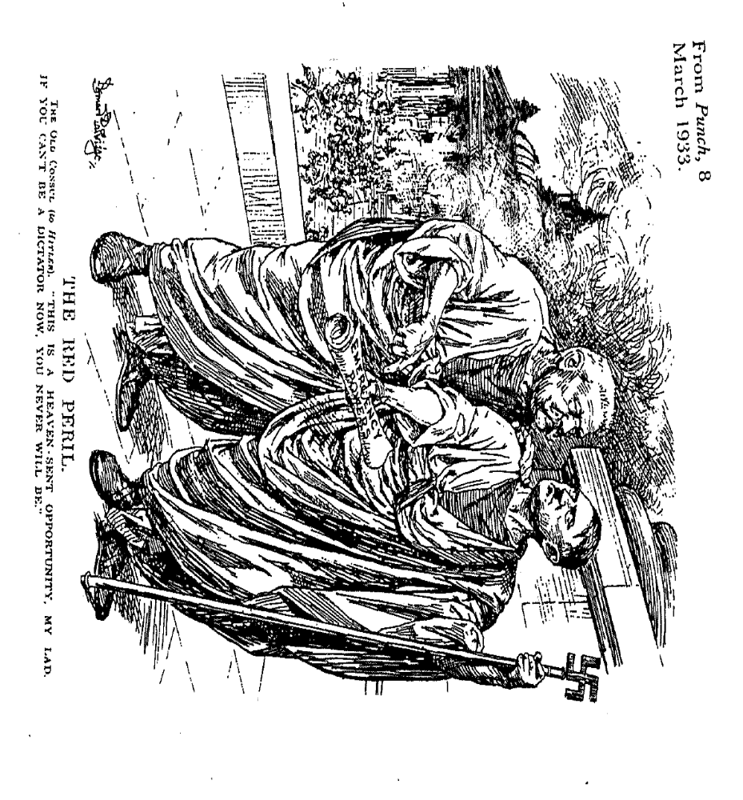

Slide 27
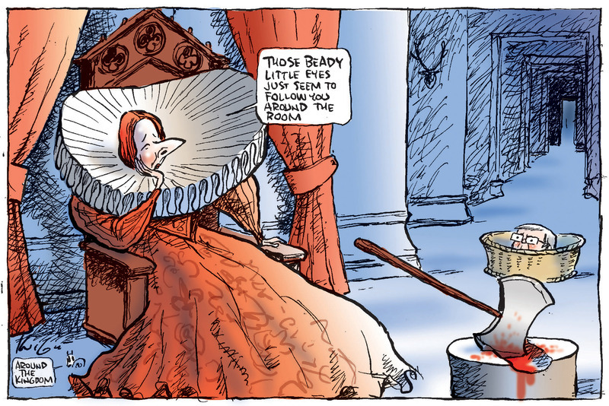
Mark Knight in Herald Sun on 15 Mar 2011, Source: Behind the Lines

Slide 28
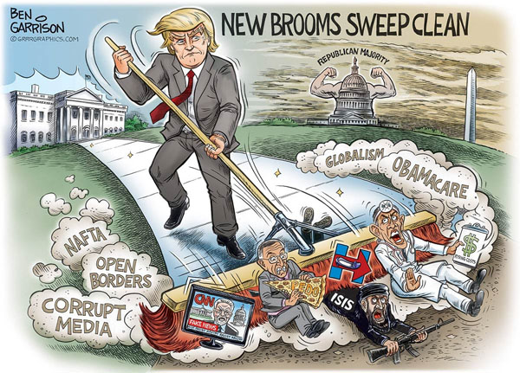
…. And just to finish off with current views of the USA and world affairs….
Ben Garrison 2016

Slide 29
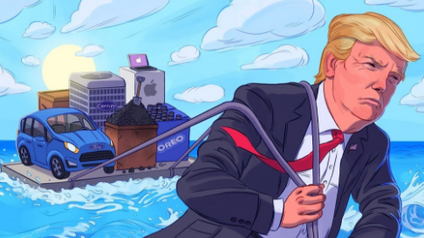

Slide 30
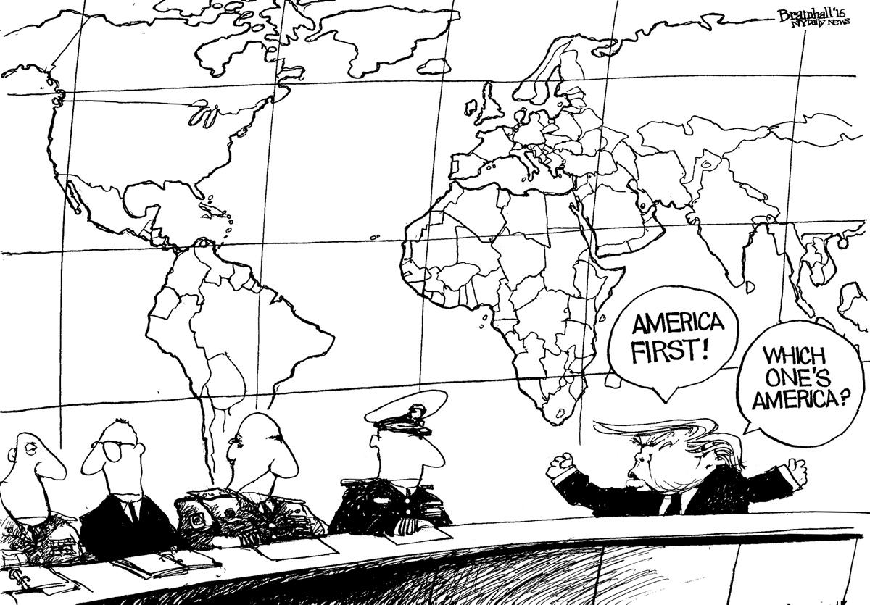
Bramhall’s World 2016

Slide 31

http://www.superbwallpapers.com/cartoons/thats-all-folks-7172/

